Slide 1
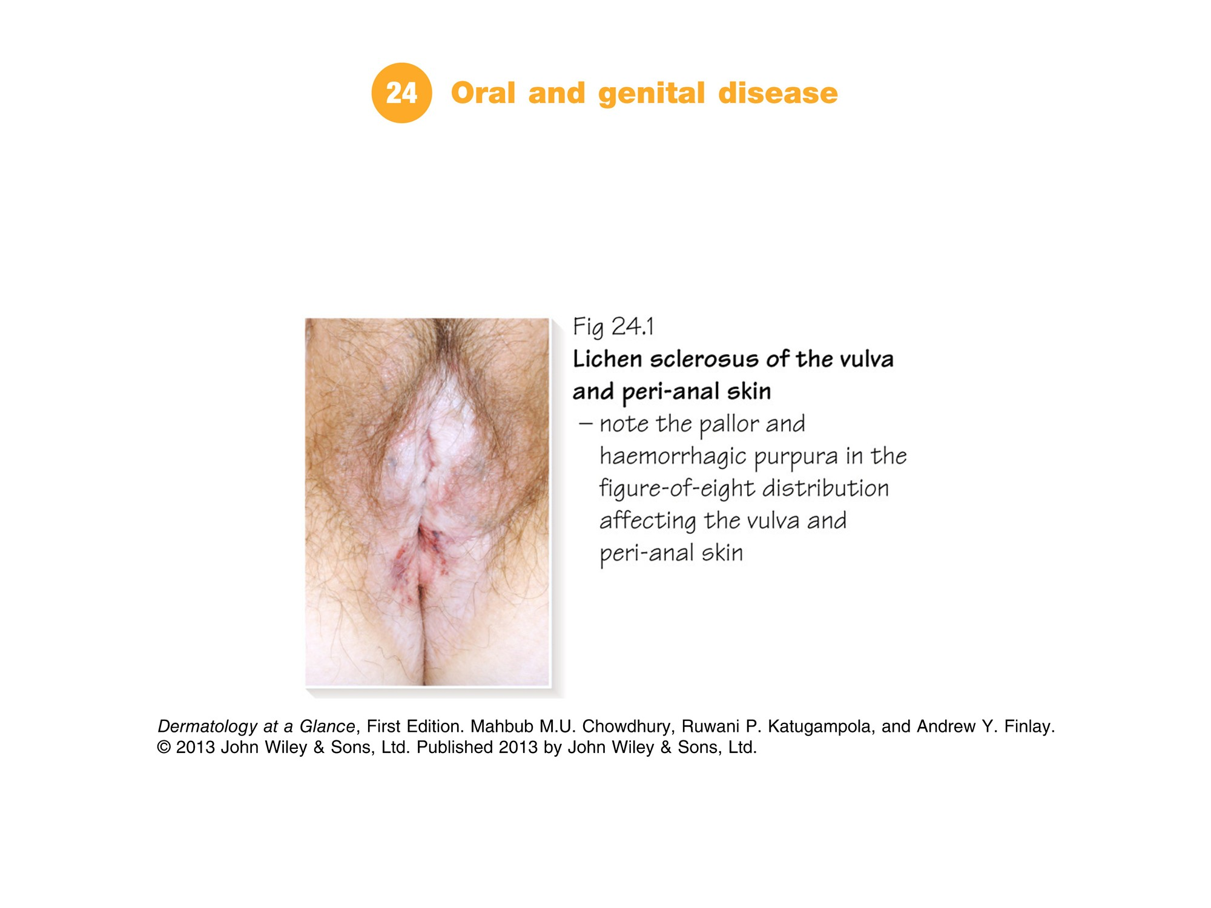
Notes:
Part 8 Specific sites
Chapter 24 Oral and genital disease | Chapter 25 Nail and hair disease

Slide 2
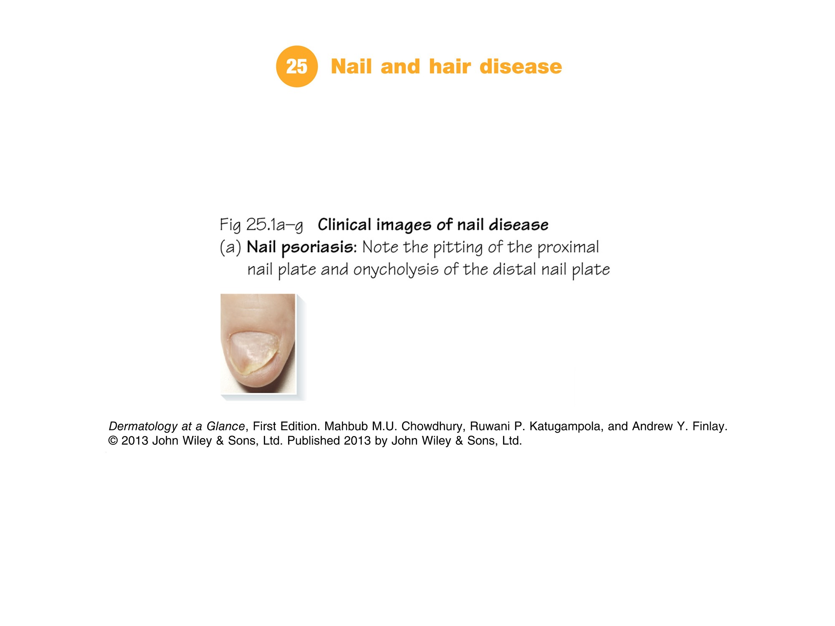

Slide 3
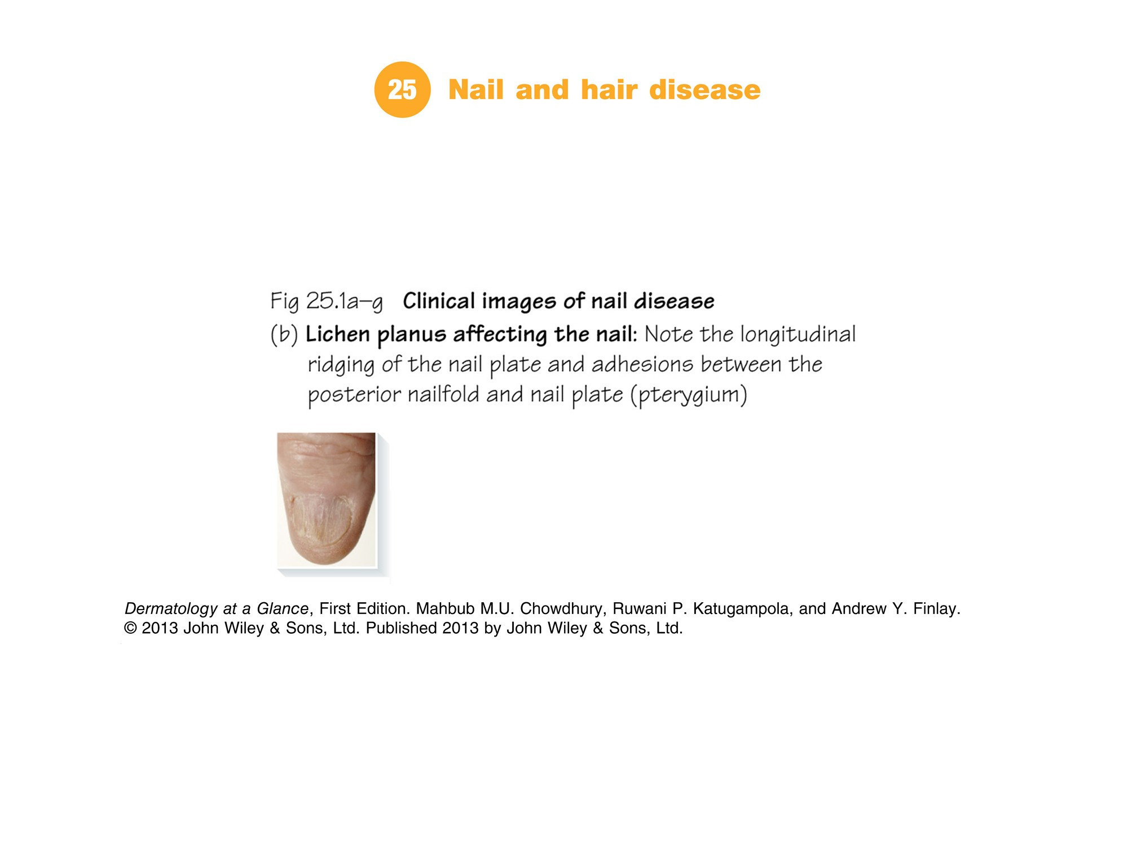

Slide 4
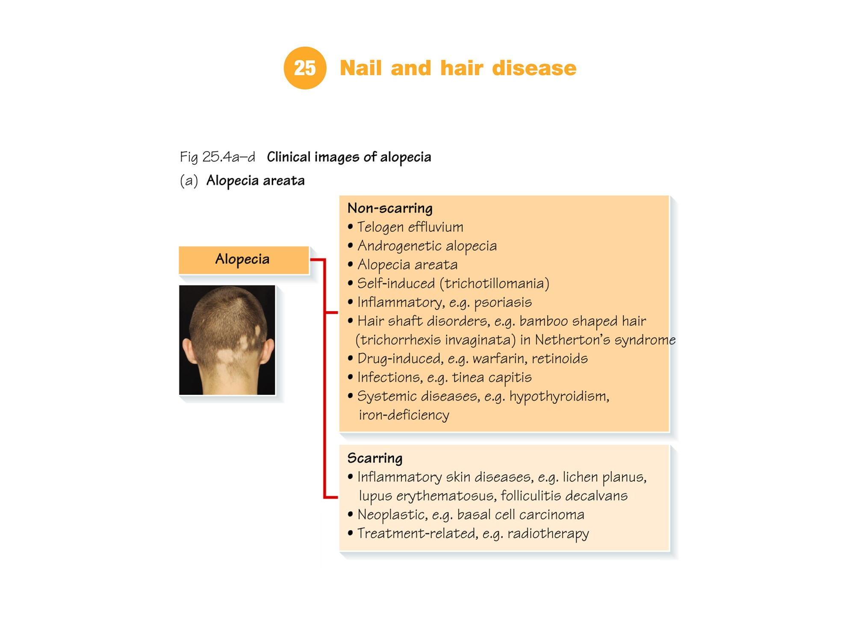

Slide 5
